Slide 1
Introduction to Machine Learning
Hiranmayi Ranganathan, LLNL
July 12, 2022

Slide 2

Hiranmayi Ranganathan
Machine Learning Researcher, Lawrence Livermore National Laboratory
My Experience
15+ years experience in Machine Learning, Computer vison, Deep learning applications
Developed many high-level theories/methods
Used machine learning for for health research
Worked in projects with DoE, NCI/NIH, & NIEHS
Education
MS, Electrical and Computer Engineering, UCSB
PhD, Deep Active Learning, Arizona State University
About Me
I grew up in Chennai, India, did my schooling and BS.
I like playing with my kids, singing and meeting friends.
I am a trained classical singer.

Slide 3
Learning Objectives
What is Machine Learning?
Main branches of Machine Learning
Machine Learning Workflow
Data Collection
Feature Engineering
Training
Validation
Testing
Evaluation, hyperparameter tuning
Scikit-Learn Examples (independent learning)

Slide 4
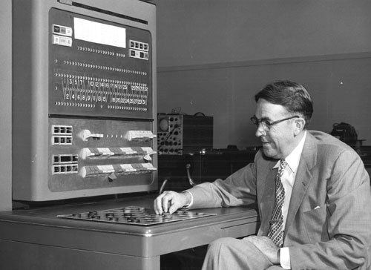

Samuel Arthur coined the term “Machine Learning” in 1959.
Field of study that gives computers the ability to learn without being explicitly programmed.
Tom Mitchell defined ML as a well-posed learning problem in 1998.
A computer program is said to learn from experience E with respect to some task T and some performance measure P, if its performance on T, as measured by P, improves with experience E.

Slide 5

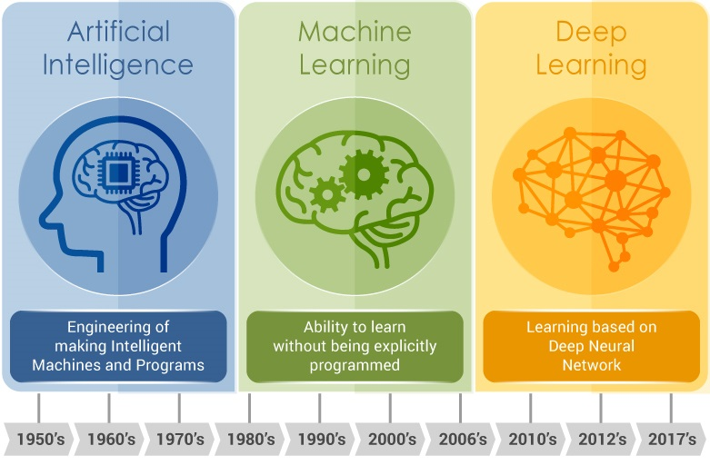
Computer Science
Artificial Intelligence
Machine Learning
Deep Learning
Image source: https://www.embedded-vision.com/industry-analysis/blog/artificial-intelligence-machine-learning-deep-learning-and-computer-visionwha

Slide 6
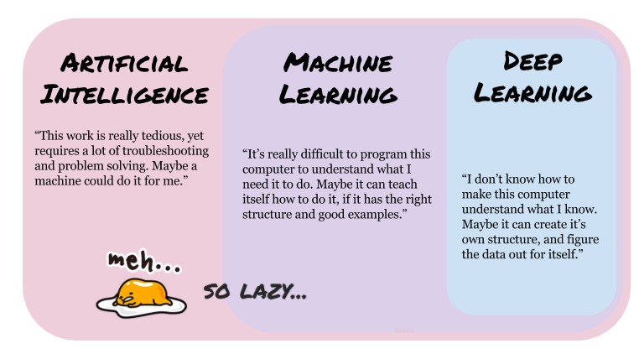
“This work is really tedious, yet requires a lot of troubleshooting and problem solving. Maybe I can get a machine to do it for me.”
“It’s really difficult to program this computer to understand what I need it to do. Maybe it can teach itself how to do it, if I can help it along by distilling the data into the meaningful examples and exposing enough of these examples to the computer.
“I don’t know the best way to distill the data into meaningful examples. Maybe if I can give it TONS of data, it can figure out what’s important from the data without my help.
Adopted from: https://medium.com/eliza-effect/ai-ml-and-deep-learning-whats-the-difference-ba6bb2223589

Slide 7
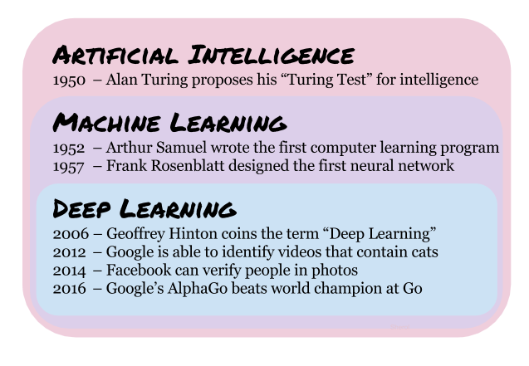
1950 – Alan Turing proposes his Turing Test for intelligence.
1952 – Arthur Samuel wrote the first computer learning program.
1957 – Frank Rosenblatt designed the first neural network.
2006 – Geoffrey Hinton coins the term “Deep Learning”.
2012 – Google is able to identify videos that contain cats.
2014 – Facebook can verify people in photos.
2016 – Google’s AlphaGo beats world champion at Go.
Image source: https://medium.com/eliza-effect/ai-ml-and-deep-learning-whats-the-difference-ba6bb2223589

Slide 8
Notes:
When I started with Data Science, I was had lot of questions concerning jargon and buzz words. We are going to spend sometime today to try and explain some of these and point you to useful resources.

Slide 9
Notes:
1)Gathering data is one of the most important stages of machine learning workflows. During data collection, you are defining the potential usefulness and accuracy of your project with the quality of the data you collect.
To collect data, you need to identify your sources and aggregate data from those sources into a single dataset. This could mean streaming data from Internet of Things sensors, downloading open source data sets, or constructing a data lake from assorted files, logs, or media.
2) Once your data is collected, you need to pre-process it. Pre-processing involves cleaning, verifying, and formatting data into a usable dataset. If you are collecting data from a single source, this may be a relatively straightforward process. However, if you are aggregating several sources you need to make sure that data formats match, that data is equally reliable, and remove any potential duplicates.
3) Once you have datasets, you are ready to train your model. This involves feeding your training set to your algorithm so that it can learn appropriate parameters and features used in classification.
4) Finally, after an acceptable set of hyperparameters is found and your model accuracy is optimized you can test your model. Testing uses your test dataset and is meant to verify that your models are using accurate features. Based on the feedback you receive you may return to training the model to improve accuracy, adjust output settings, or deploy the model as needed.
5) Once training is complete, you can then refine the model using your validation dataset. This may involve modifying or discarding variables and includes a process of tweaking model-specific settings (hyperparameters) until an acceptable accuracy level is reached.

Slide 10
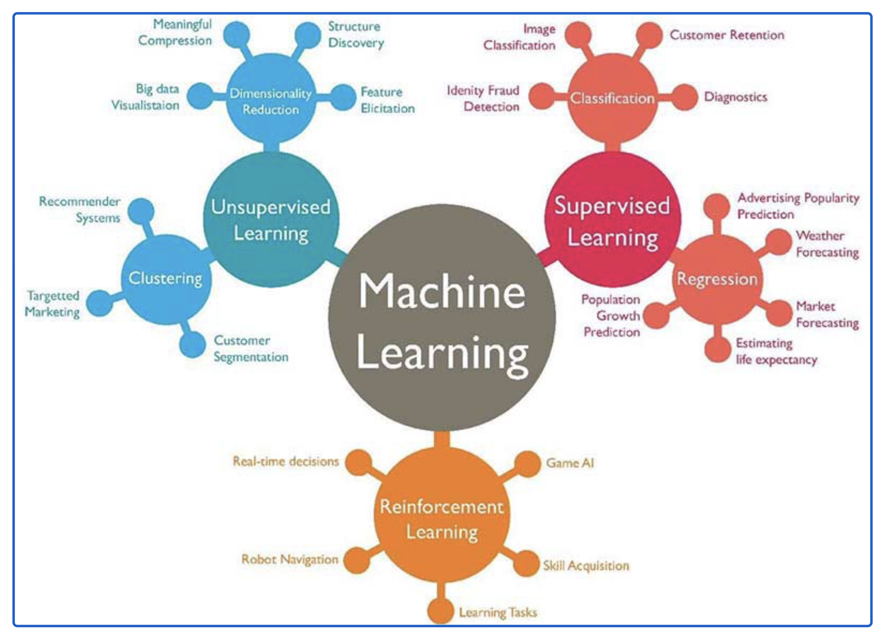
Machine Learning Approaches
Notes:
Types of Machine Learning?
Machine learning can be classified into 3 types of algorithms.
Supervised Learning — [Link coming soon in a future blog]
Unsupervised Learning — [Link coming soon in a future blog]
Reinforcement Learning — [Link coming soon in a future blog]

Slide 11
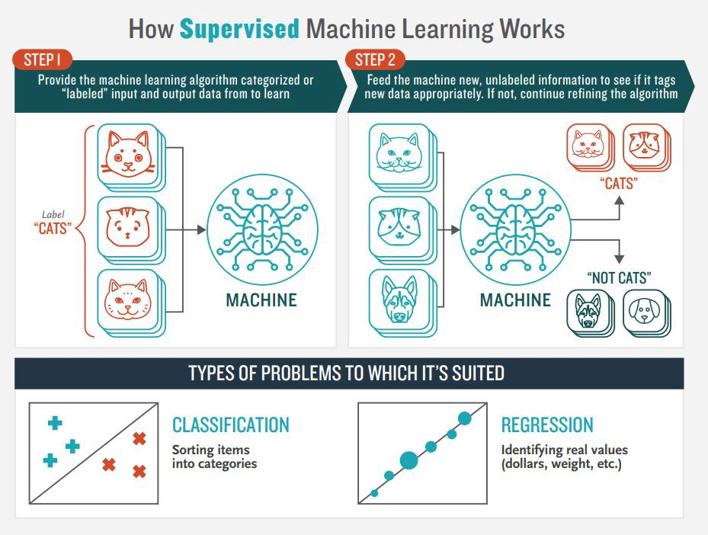
Image source: boozallen.com
Notes:
Algorithms are the key to machine learning
You’ve heard of machine learning and seen what it can do, but how exactly do machines learn? The short answer: Algorithms. We feed algorithms, which are sets of rules used to help computers perform problem-solving operations, large volumes of data from which to learn. Generally, the more data a machine learning algorithm is provided the more accurate it becomes.
Machine learning algorithms are split into two main categories based on how they interact with data: Supervised and unsupervised. Due to their differences when analyzing data, these two machine learning categories are better suited for solving different problems. All forms of machine learning rely on the availability of a huge quantity of data to train algorithms. In the infographic below you’ll see how both supervised and unsupervised ingest this data and which problems they are suited for solving.

Slide 12
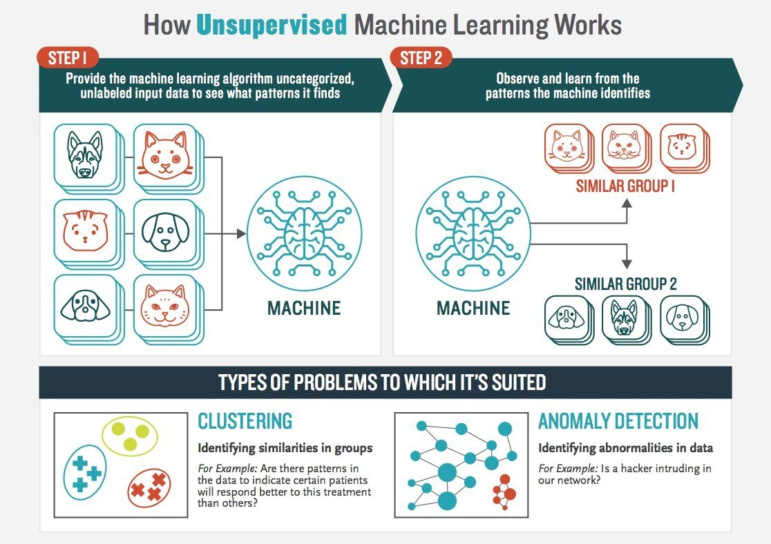
Image source: boozallen.com

Slide 13
Overview of models under categories

Slide 14
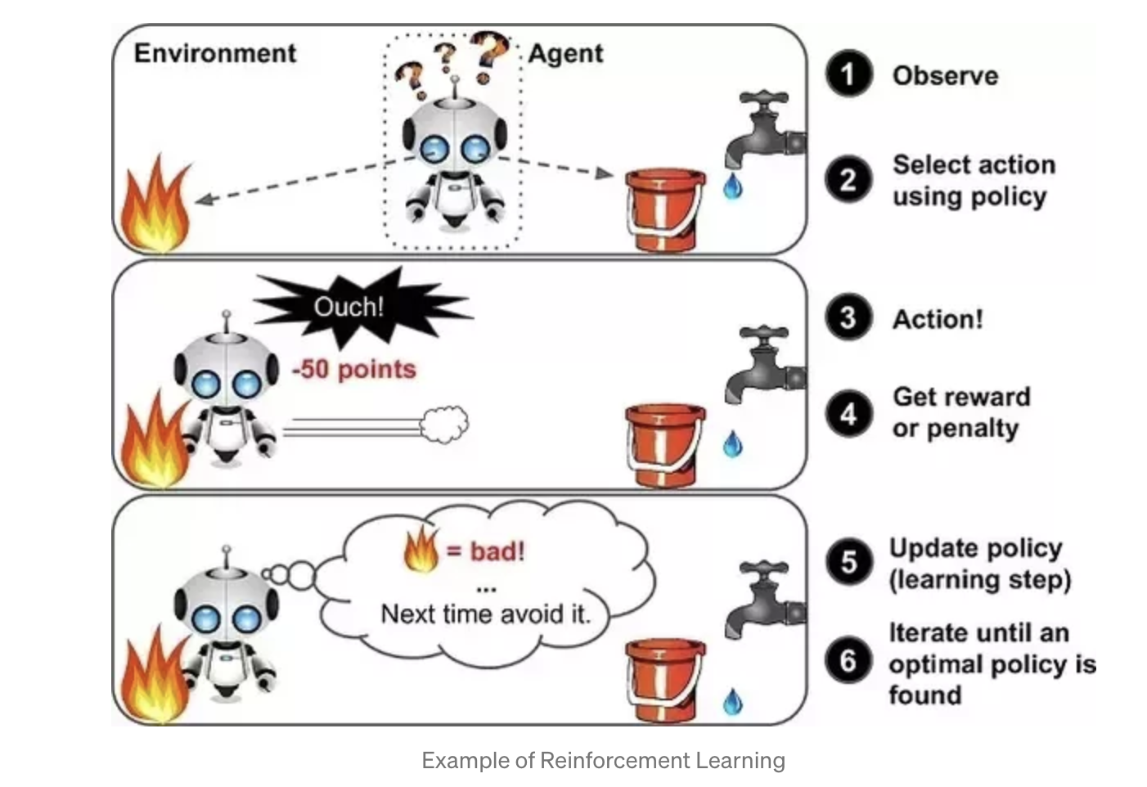
Overview of Reinforcement Learning
https://towardsdatascience.com/introduction-to-machine-learning-for-beginners-eed6024fdb08
Notes:
A reinforcement learning algorithm, or agent, learns by interacting with its environment. The agent receives rewards by performing correctly and penalties for performing incorrectly. The agent learns without intervention from a human by maximizing its reward and minimizing its penalty. It is a type of dynamic programming that trains algorithms using a system of reward and punishment.
In the above example, we can see that the agent is given 2 options i.e. a path with water or a path with fire. A reinforcement algorithm works on reward a system i.e. if the agent uses the fire path then the rewards are subtracted and agent tries to learn that it should avoid the fire path. If it had chosen the water path or the safe path then some points would have been added to the reward points, the agent then would try to learn what path is safe and what path isn’t.
It is basically leveraging the rewards obtained, the agent improves its environment knowledge to select the next action.

Slide 15
The ML workflow
Define the Problem appropriately
Collect Data
Choose a Measure of Success

Slide 16
The ML workflow
Define Appropriately the Problem
Collect Data
Choose a Measure of Success:
Preparing The Data

Slide 17
Methods of Preparing The Data
Dealing with missing data
Handling Caterogical Data
Feature Scaling

Slide 18
The ML workflow
Define Appropriately the Problem
Collect Data
Choose a Measure of Success:
Preparing The Data
Splitting Data Into Subsets

Slide 19
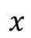
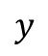
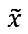
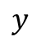
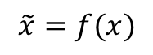
Feature
engineering
Input
Target
Input
Target

Slide 20
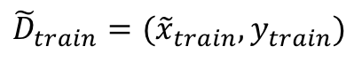
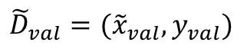
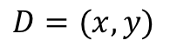
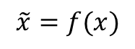
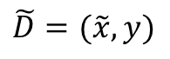
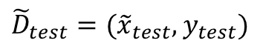
Disjoint data splits
Training data
Worked out examples for studying
Feature
engineering
Data
partitioning
Raw input
& target
Processed input & target
Validation data
Practice examples to try on your own
Test data
Exam questions

Slide 21
The ML workflow
Define Appropriately the Problem
Collect Data
Choose a Measure of Success:
Preparing The Data
Splitting Data Into Subsets
Training the Model

Slide 22
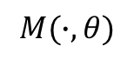
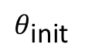
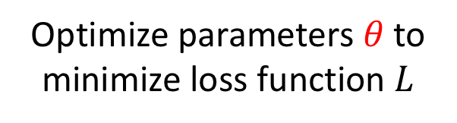
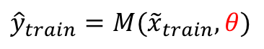
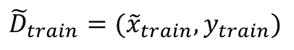
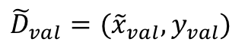
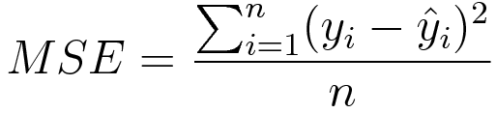
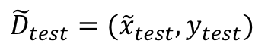
Choose ML algorithm
Disjoint data splits
Train ML model
Training data
Validation data
Test data

Slide 23
A Machine Learning Model

Slide 24
Cost function
Let’s say, there are a total of ’N’ points in the dataset and for all those ’N’ data points we want to minimize the error. So the Cost function would be the total squared error i.e
How do we actually minimize any function?
Cost function is of the form Y = X²

Slide 25
Gradient Descent
Possible actions would be:
You might go upward or downward
If you decide on which way to go, you might take a bigger step or a little step to reach your destination.
Essentially, there are two things that you should know to reach the minima, i.e. which way to go and how big a step to take.
The slope at the blue point is less steep than that at the green point which means it will take much smaller steps to reach the minimum from the blue point than from the green point.
The Minimum Value

Slide 26
Mathematical Interpretation of Cost Function

Slide 27
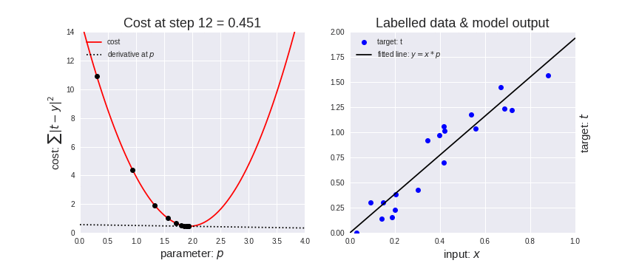
Gradient Descent

Slide 28
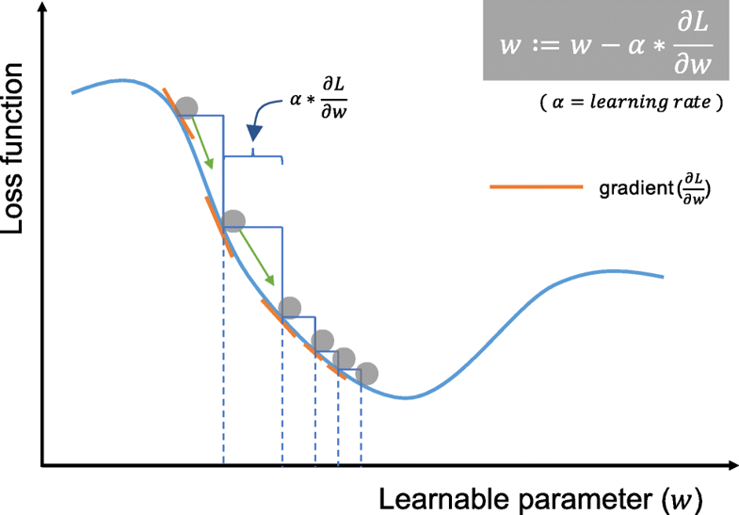
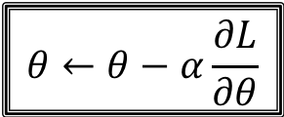
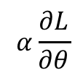
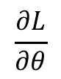

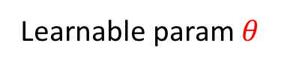
Choose ML algorithm
Disjoint data splits
Train ML model
Training data
Validation data
Test data
Image adopted from Yamashita et al. (2018)

Slide 29
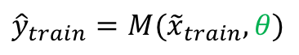
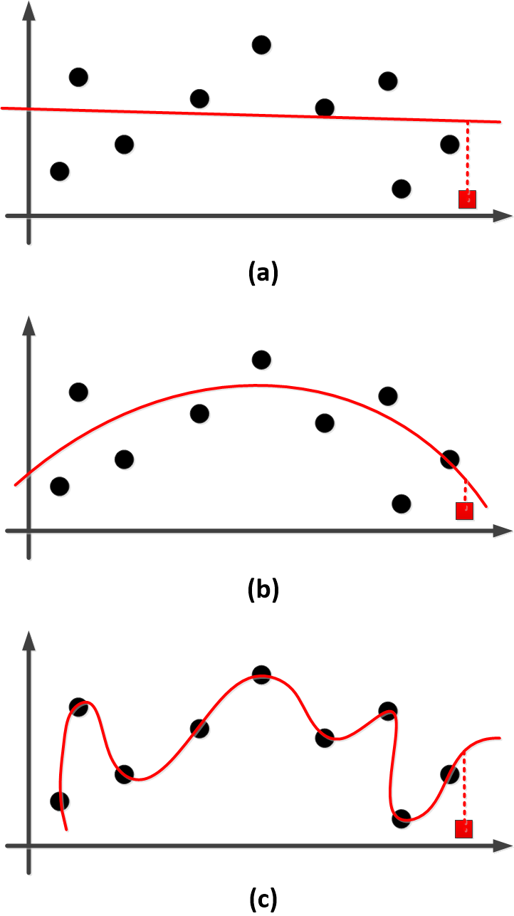
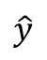
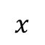
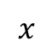
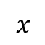
Choose ML algorithm
Disjoint data splits
Train ML model
After training, if we freeze the parameters, how good is the model?
Training data
Training examples
Validation data
New example
Test data
Underfitting
Good fit!
Overfitting
Image source: https://deeplearn.org/arxiv/77795/the-theory-behind-overfitting,-cross-validation,-regularization,-bagging,-and-boosting:-tutorial

Slide 30
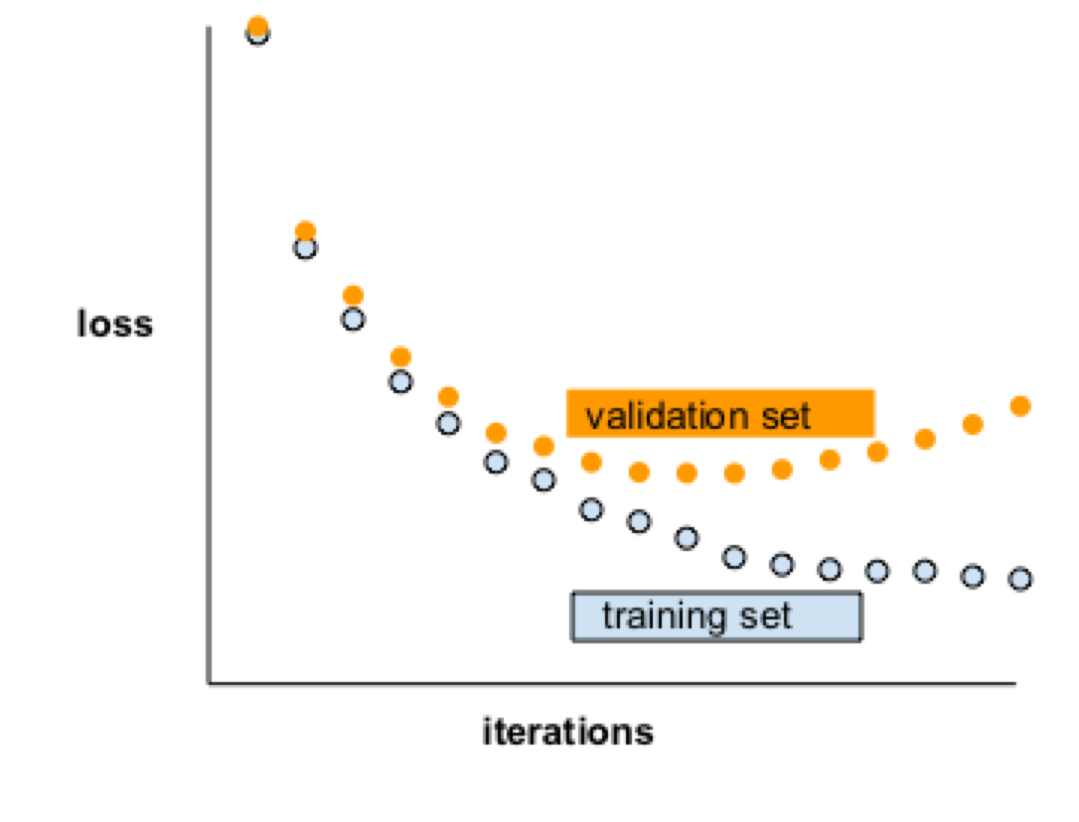

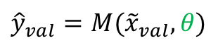

Training set
Validation set
Choose ML algorithm
Loss
Disjoint data splits
Train ML model
Training data
Validate ML model
Validation data
Test data
Training epoch

Slide 31
Training set
Validation set
Choose ML algorithm
Loss
Disjoint data splits
Train ML model
Training data
Validate ML model
Validation data
Test data
Training epoch

Slide 32
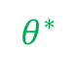
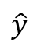
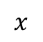
Training set
Validation set
Choose ML algorithm
Optimum
Loss
Disjoint data splits
Train ML model
Training data
Validate ML model
Validation data
Test data

Slide 33
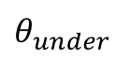
Training set
Validation set
Choose ML algorithm
Underfitting
Optimum
Loss
Disjoint data splits
Train ML model
Training data
Validate ML model
Validation data
Test data

Slide 34
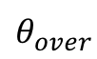
Training set
Validation set
Choose ML algorithm
Underfitting
Optimum
Overfitting
Loss
Disjoint data splits
Train ML model
Training data
Validate ML model
Validation data
Test data

Slide 35
The ML workflow
Define Appropriately the Problem
Collect Data
Choose a Measure of Success:
Preparing The Data
Splitting Data Into Subsets
Training the Model
Test the the Model

Slide 36
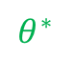
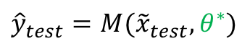
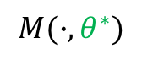
Choose ML algorithm
Disjoint data splits
Train ML model
Training data
Validate ML model
Validation data
Test data
Eval trained ML model
Troubleshoot
Sufficient data?
Right features?
Right model?
Proper training?

Slide 37
Evaluate your Machine Learning Algorithm
Evaluating your machine learning algorithm is an essential part of any project.
Classification Accuracy
Logarithmic Loss
Confusion Matrix
Area under Curve
F1 Score
Mean Absolute Error
Mean Squared Error
https://towardsdatascience.com/metrics-to-evaluate-your-machine-learning-algorithm-f10ba6e38234

Slide 38
The ML workflow
Define Appropriately the Problem
Collect Data
Choose a Measure of Success:
Preparing The Data
Splitting Data Into Subsets
Training the Model
Test the the Model
Tune Hyperparameters
https://medium.com/criteo-labs/hyper-parameter-optimization-algorithms-2fe447525903

Slide 39
Introduction to Machine Learning using Scikit-Learn
Scikit-learn is probably the most useful library for machine learning in Python. The sklearn library contains a lot of efficient tools for machine learning and statistical modeling including classification, regression, clustering and dimensionality reduction
Tutorials
https://scikit-learn.org/stable/
https://scikit-learn.org/stable/tutorial/basic/tutorial.html
https://www.guru99.com/scikit-learn-tutorial.html
ML Projects for beginners
https://github.com/jakevdp/sklearn_tutorial
https://www.guru99.com/scikit-learn-tutorial.html
https://elitedatascience.com/machine-learning-projects-for-beginners

Slide 40
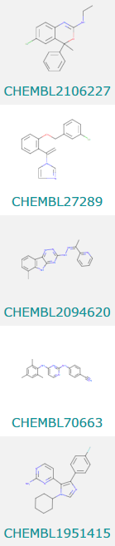


Chemoinformatics datasets
Compound ID Structure MW AlogP Target Active IC50 (uM)
CHEMBL2106227
CHEMBL27289
CHEMBL2094620
CHEMBL70633
CHEMBL1951415
Aurora kinase B
Aurora kinase B
Aurora kinase B
Aurora kinase B
Aurora kinase B
False 1.5
False 3
True 0.10
False > 100
False > 100

Slide 41
Types of machine learning tasks
Compound ID Structure Active IC50 (uM)
Classification task
(with classes)
CHEMBL2106227
CHEMBL27289
CHEMBL2094620
CHEMBL70633
CHEMBL1951415
False 1.5
False 3
True 0.10
False > 100
False > 100
Regression task
(with numerical values)

Slide 42
What is QSAR?
Quantitative Structure Activity Relationships (QSAR)
1.5
3
0.10
> 100
> 100
?

Slide 43
How do we encode molecules?
There are many featurization approaches
SMILES
CC(=O)Nc1ccc(O)cc1
1.5
3
0.10
> 100
> 100
?
Fingerprints
A | B | C | D | E | F | G | H | I | …
1 | 0 | 0 | 1 | 0 | 0 | 1 | 1 | 0 | …
Molecular descriptors
clogD | TPSA | QM | …
3.1 | 10.2 | 4.1 | …

Slide 44

How do we predict a property?
Fit machine learning models and parameters to predict properties
1.5
3
0.10
> 100
> 100
Neural network
Mathematical functions
Parameters for functions
Featurization
Random Forest
Decision trees based on features
Forest: Collection of decision trees

Slide 45

What about Deep Learning?
Deep convolutional neural networks (DCNN) have been successful in a variety of tasks
Image recognition
Natural language processing
AlphaGo
Can we use this type of model for chemoinformatics models?
Izadyyazdanabadi Frontiers Oncology 2018

Slide 46


Deep learning for QSAR
Yes, there are now several deep models for chemistry applications
DeepChem
MoleculeNet
1.5
3
0.10
> 100
> 100
Machine learning model
ChemProp
Others…
Wu arXiv:1703.00564v3

Slide 47

Is it a good model?
Does our model accurately predict the property of interest for a set of compounds of interest?
Model performance
Domain of applicability
Predicted property
100
10
0.001
Fit model with associated parameters
New compounds
Does the model just memorize information or does it generalize to new cases?

Slide 48

How can we test our model?
Generally we would like to test our model predictions prospectively on new test compounds to be measured
For fitting, we can artificially split the data into sets
Training
Validation
Test
Then for the withheld test set, we can compare predicted vs. experimental values
Valid
Dataset splitting
Training
Test
Predicted vs. experimental values

Slide 49
ATOM Modeling PipeLine validation

Slide 50

Safety validation classification models
Model target assay
Splitting method | Scaffold based
Model types | Neural network, random forest
Neural network and random forest models were able to differentiate between active and inactive test compounds on these tasks
Best model test set ROC AUC

Slide 51

Pharmacokinetics validation regression models
Model property assay
Splitting method | Scaffold based
Features | Extended connectivity fingerprint (ECFP), graph convolution (DeepChem), Mordred, MOE
Model types | Neural network, random forest
Neural network and random forest models were able to predict many PK properties
Best model scaffold-split test set R²

Slide 52

Effect of dataset size: Big data
Test set R²
Dataset size (number of compounds)
Larger datasets were beneficial for fitting models for pharmacokinetics properties

Slide 53

Effect of feature and model types: Which is better?
Count of best pharmacokinetics models by featurization type
Graph convolutional DeepChem featurization worked well with neural network models
MOE descriptors worked well with random forest models

